Slide 1
Power Consumption

Slide 2
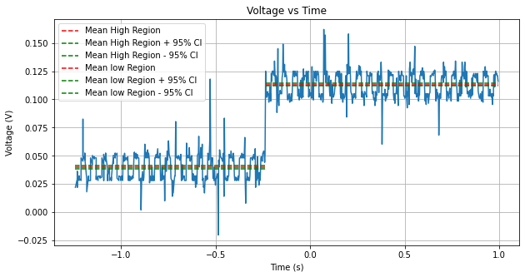
FPU Addition
For 6,400,000 operations
High Region Time Length (s) | 1.228
Voltage Difference (mV) | 73.276
Power per operation (pW) | 0.839
Total Energy per operation (pJ) | 1.03

Slide 3
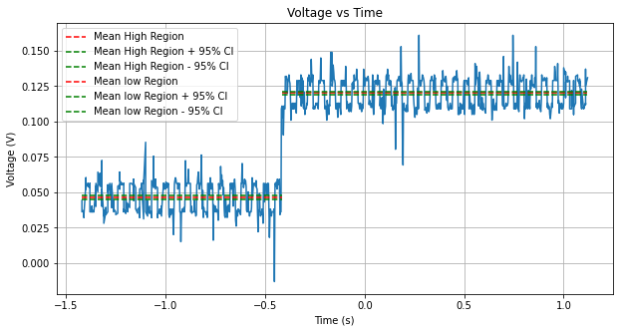
FPU Multiplication
For 6,400,000 operations
High Region Time Length (s) | 1.533
Voltage Difference (mV) | 73.65
Power per operation (pW) | 0.847
Total Energy per operation (pJ) | 1.299

Slide 4
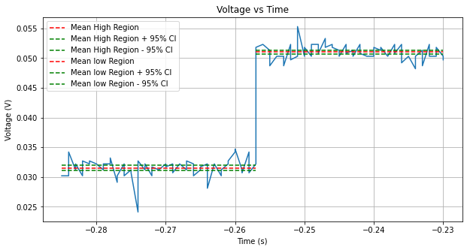
Ann 4/29 (784, relu, 256, relu,10)
High Region Time Length (ms) | 27
Voltage Difference (mV) | 19.45
Power (uW) | 378.438
Total Energy (uJ) | 10.2

Slide 5
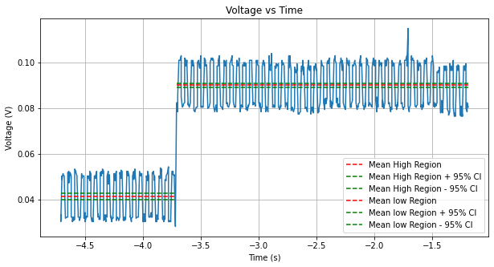
Snn 4/29 (LIF 784,256,10)
High Region Time Length (s) | 2.52
Voltage Difference (mV) | 48.735
Power (mW) | 2.375
Total Energy (mJ) | 5.985

